Slide 1
Machine Learning
Lecture 15: Clustering

Slide 2

Unsupervised learning introduction
Clustering
Machine Learning

Slide 3


Supervised learning
Training set:

Slide 4
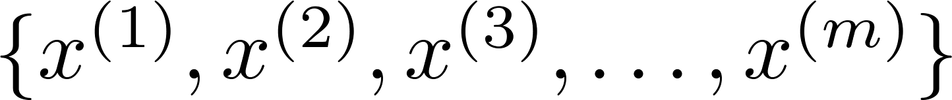
Unsupervised learning
Training set:

Slide 5


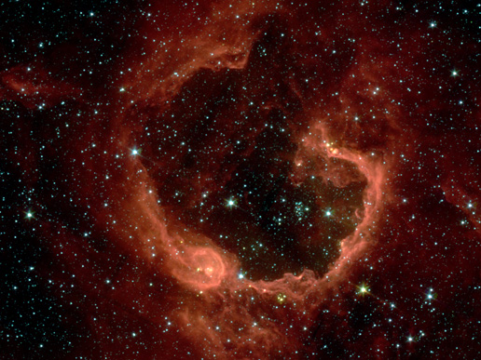
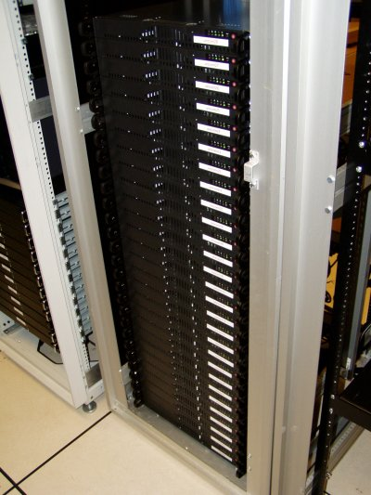
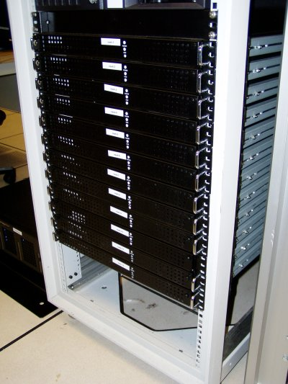
Applications of clustering
Market segmentation
Social network analysis
Image credit: NASA/JPL-Caltech/E. Churchwell (Univ. of Wisconsin, Madison)
Organize computing clusters
Astronomical data analysis
Notes:
Swap: market seg and organize clusters

Slide 6
K-means algorithm
Clustering
Machine Learning

Slide 7
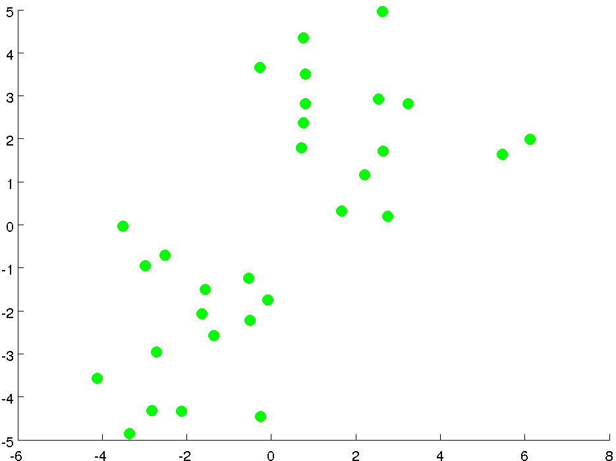

Slide 8
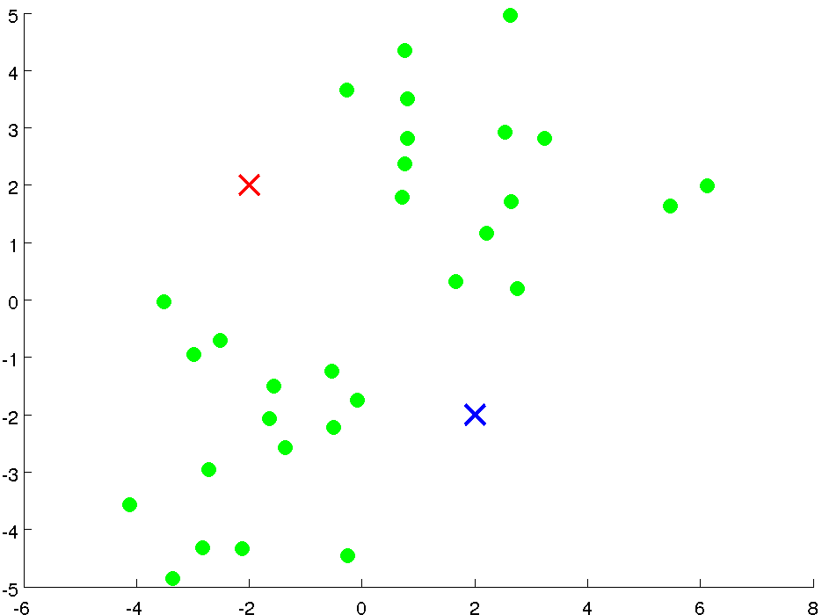
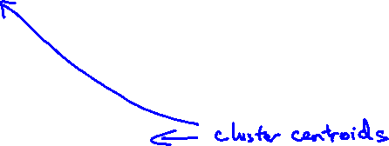

Slide 9
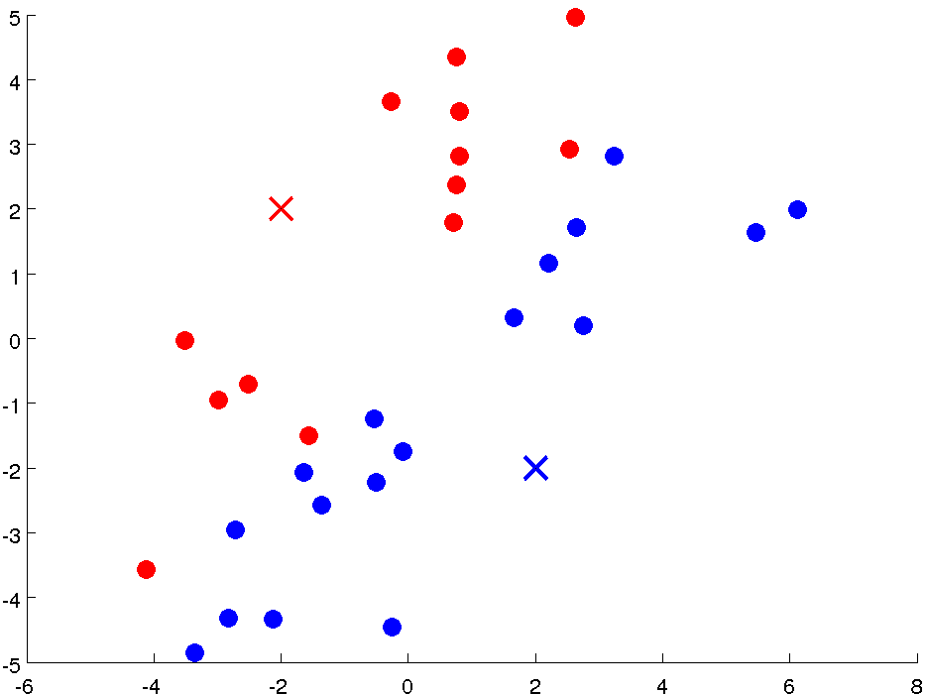

Slide 10
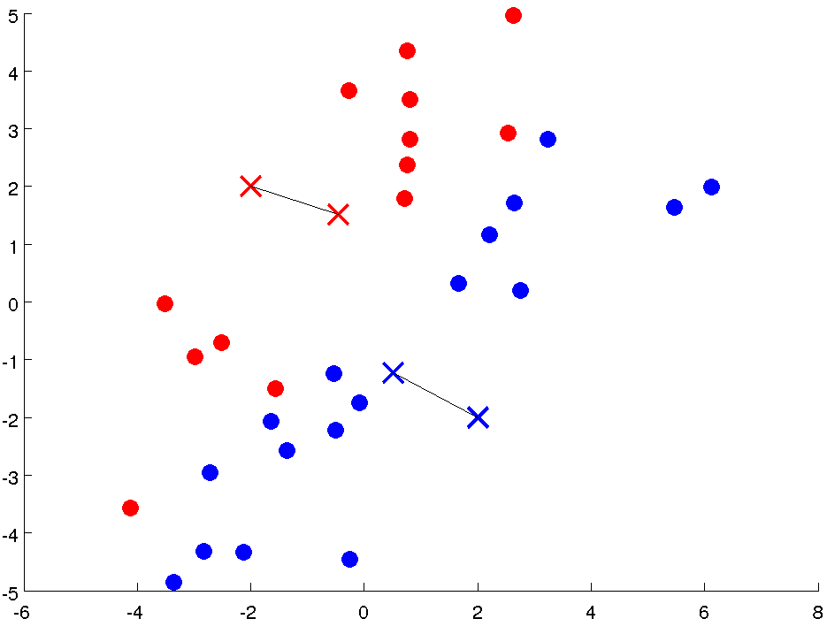

Slide 11
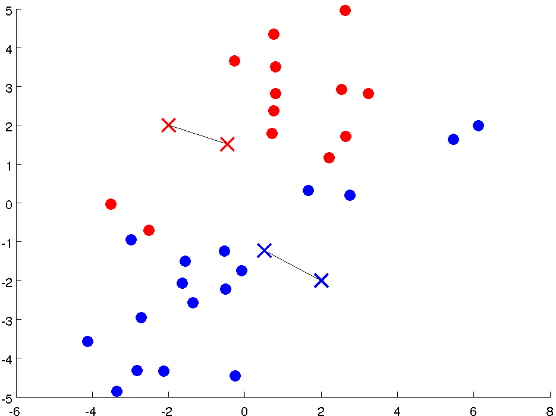

Slide 12
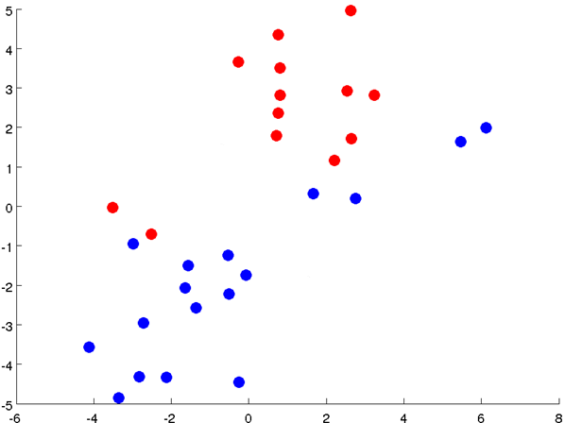

Slide 13
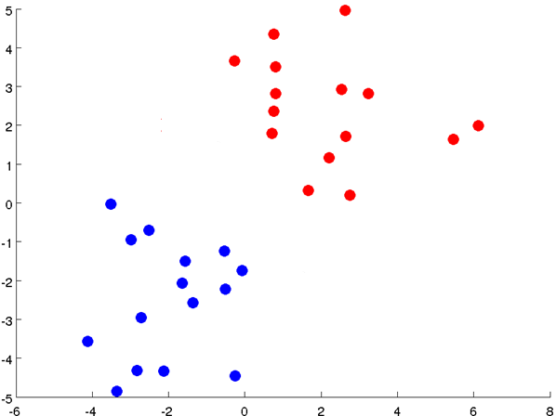

Slide 14
Notes:
Get rid of the legacy points

Slide 15
Notes:
Get rid of the legacy points

Slide 16
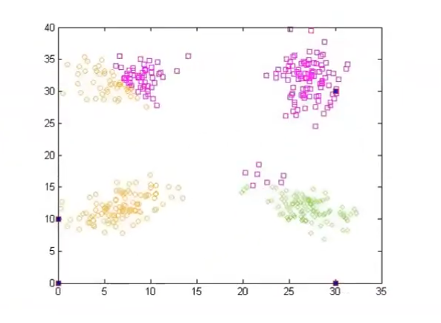
Example
K=4.

Slide 17
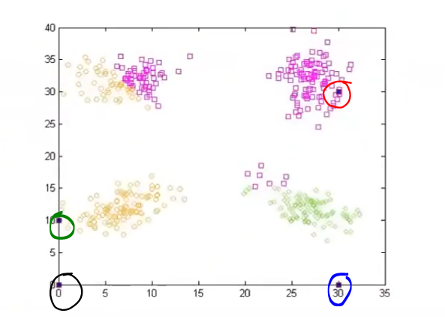
Initial Centroids

Slide 18
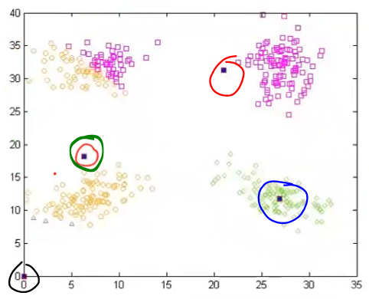
Iteration 1: Updated Centroids

Slide 19
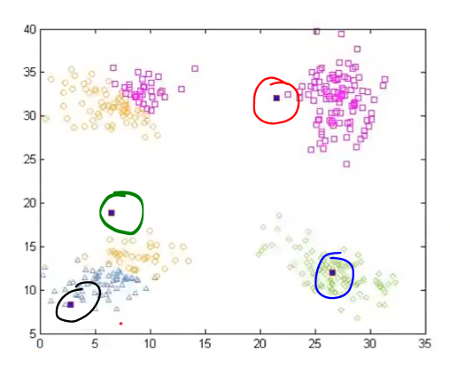
Iteration 2: Update Centroids

Slide 20
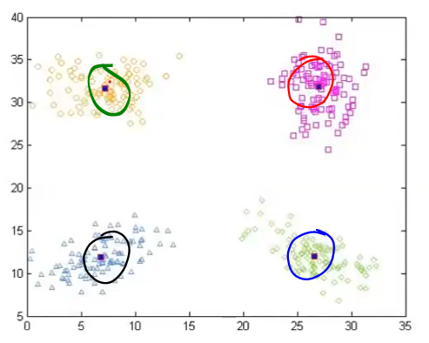
Iteration 3: Updated Centroids

Slide 21
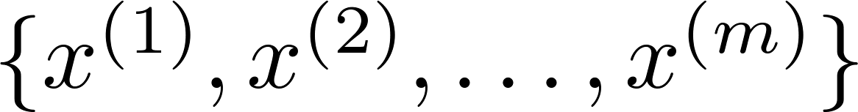
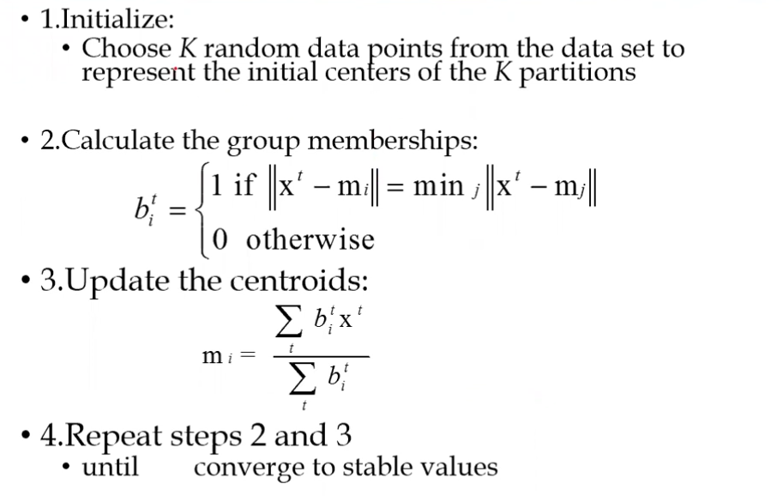
K-means algorithm
Input:
K (number of clusters)
Training set

Slide 22
Example: K-means Clustering Algorithm
Clustering
Machine Learning

Slide 23
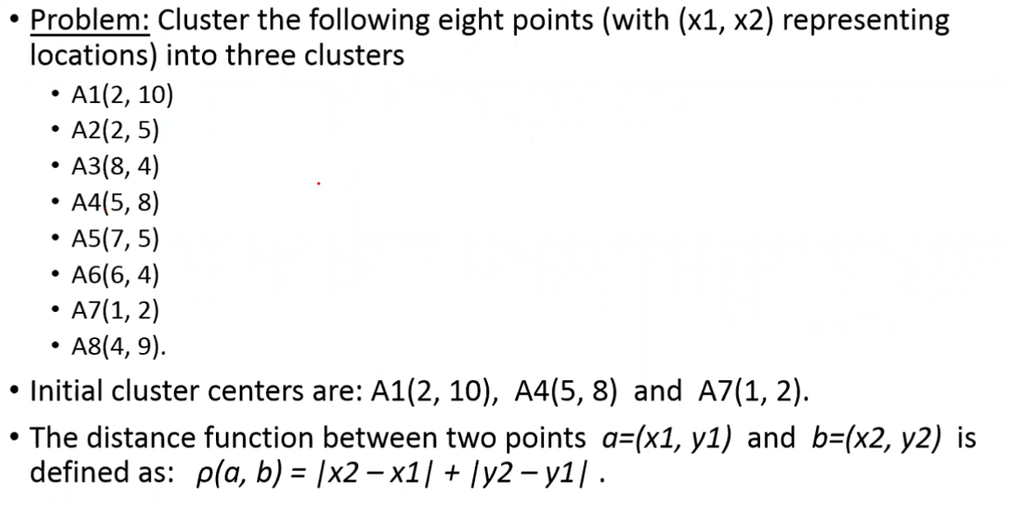

Slide 24
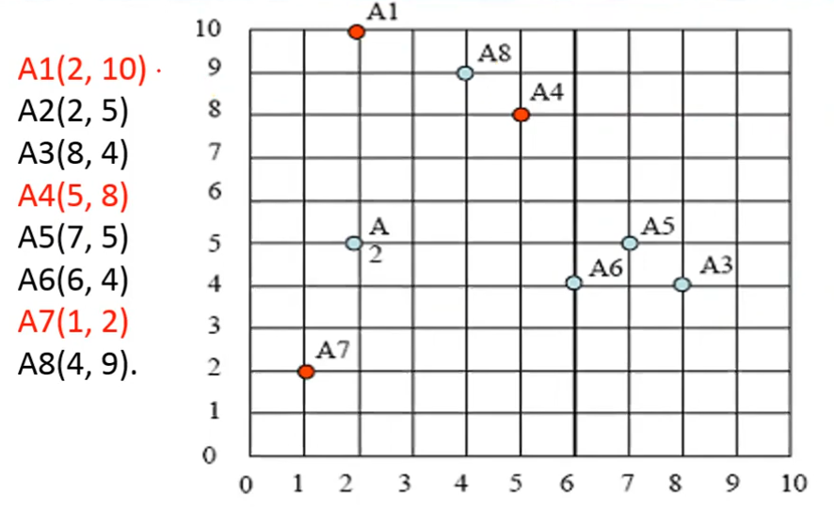

Slide 25
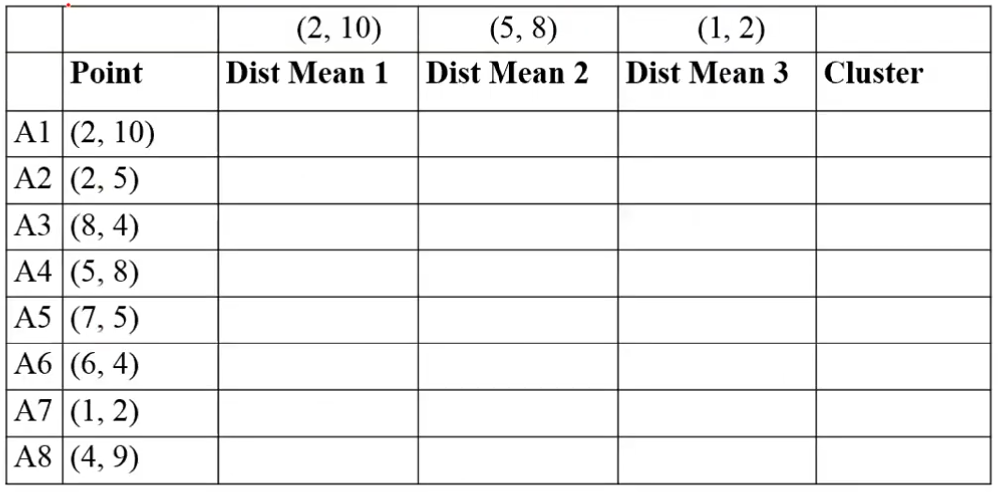

Iteration 1

Slide 26
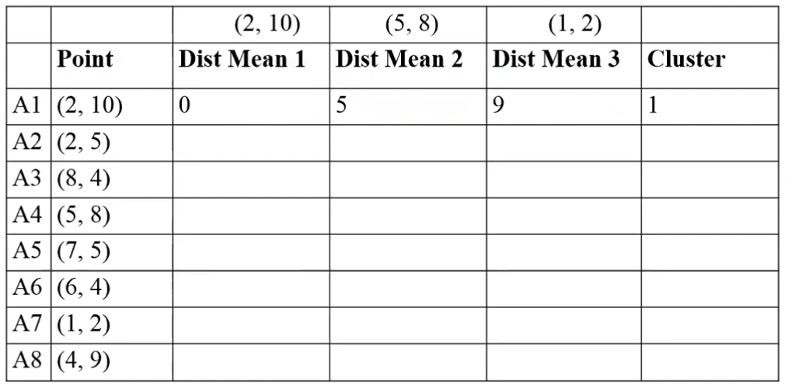

Slide 27
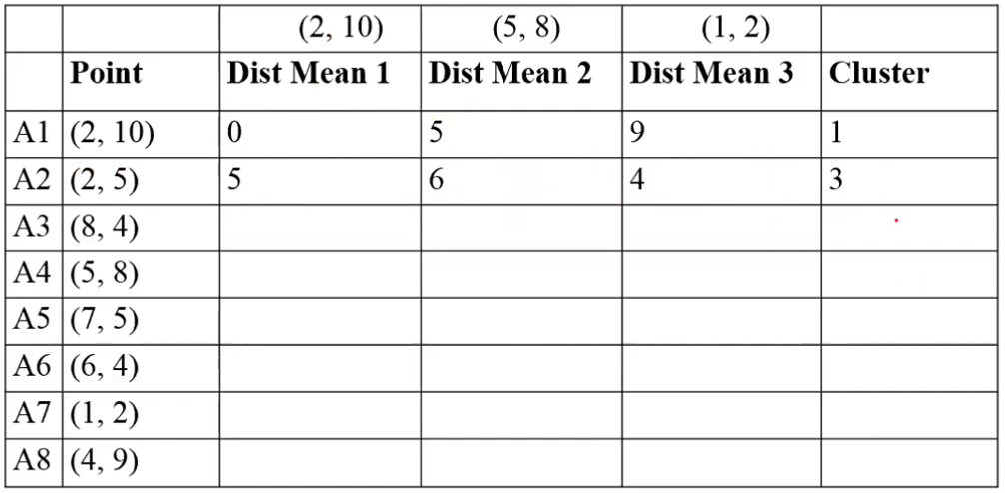

Slide 28
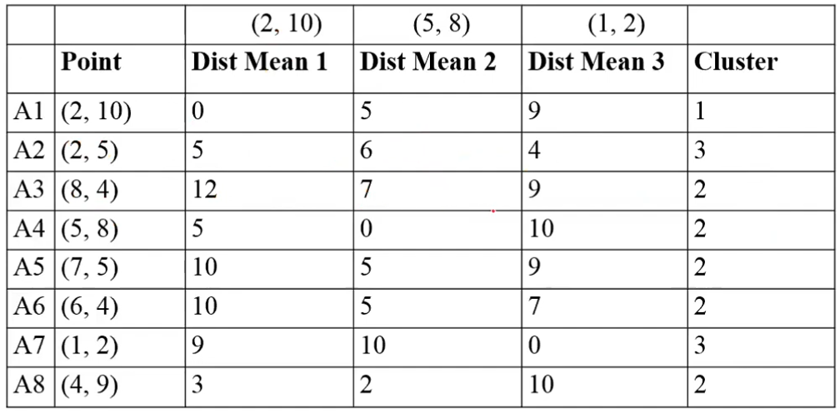

Slide 29
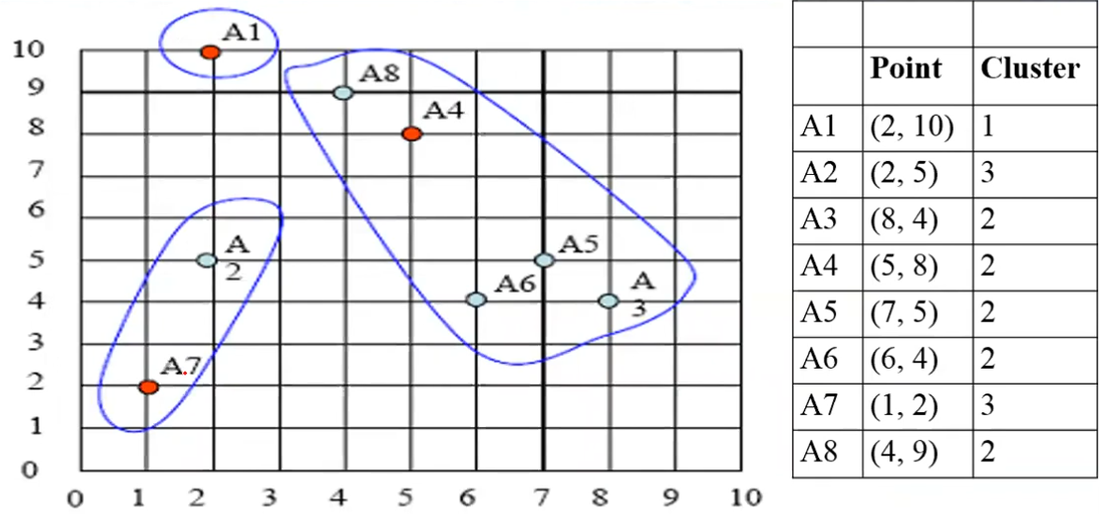
Membership overview

Slide 30
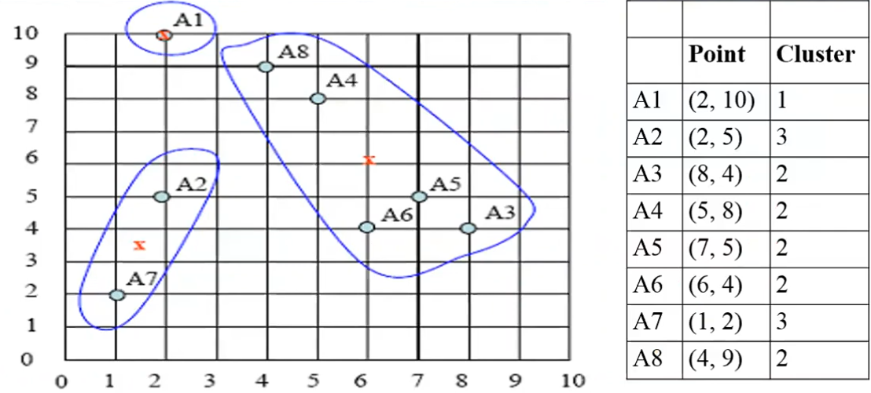
Centroid Update

Slide 31
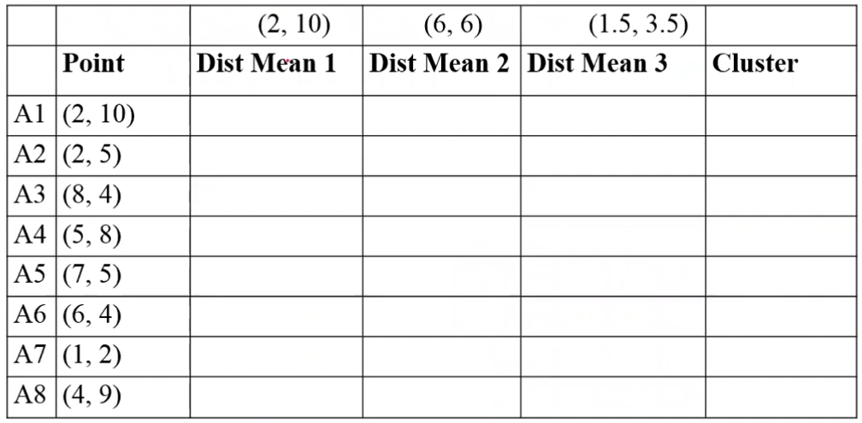
Iteration 2: Do It Yourself!

Slide 32
Iteration 3: Do It Yourself!

Slide 33
Clustering
Random initialization
Machine Learning

Slide 34



Random initialization
Should have
Randomly pick training examples.
Set equal to these
examples.
Notes:
LATEX font

Slide 35
Local optima

Slide 36
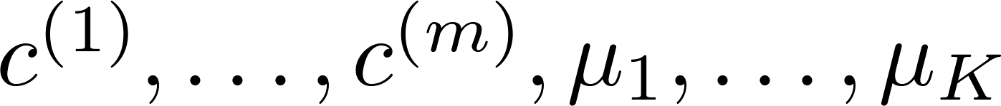
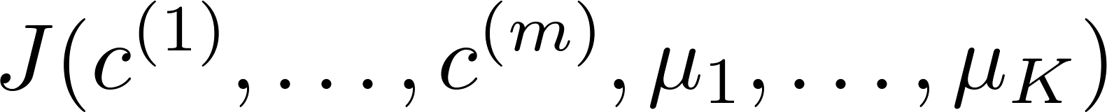
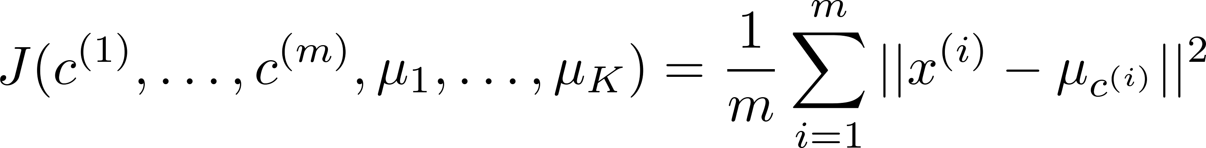
Random initialization
For i = 1 to 100 {
Randomly initialize K-means.
Run K-means. Get .
Compute cost function (distortion)
}
Pick clustering that gave lowest cost
The distortion function in k-means clustering measures the sum of squared distances between each data point and its assigned cluster centroid, representing the total error of the clusters.
Cost function (distortion) =

Slide 37
Visualize Clustering in Action
https://www.naftaliharris.com/blog/visualizing-k-means-clustering/

Slide 38
Choosing the number of clusters
Clustering
Machine Learning

Slide 39
What is the right value of K?

Slide 40
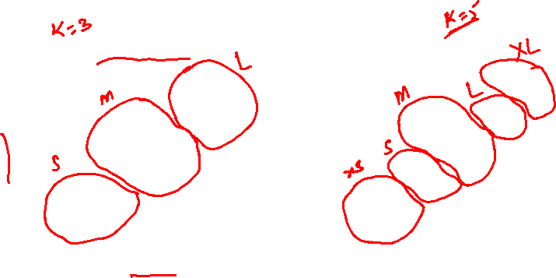
Choosing the value of K.
T-shirt sizing
T-shirt sizing
Weight
Weight
Height
Height

Slide 41


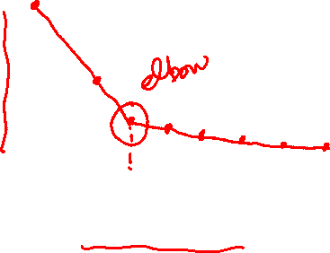
Choosing the value of K
Elbow method:
Cost function
(no. of clusters)

